Slide 1
Introduction to Programming (II)
Exception Handling in
12224 – Doubly Linked List

Slide 2
Description
Maintain a doubly linked list, which supports the following operations:
IH i : Insert a new integer i to the head of the list.
IT i : Insert a new integer i to the tail of the list.
RH : Print and remove the element in the head of the list. If the list is empty, print a blank line.
RT : Print and remove the element in the tail of the list. If the list is empty, print a blank line.
S : Swap

Slide 3
Outline
Implementation of RemoveHead()
Contradiction with RemoveHead()
Try catch in main()
Add an if statement in RemoveHead()

Slide 4
Outline
Implementation of RemoveHead()
Contradiction with RemoveHead()
Try catch in main()
Add an if statement in RemoveHead()

Slide 5
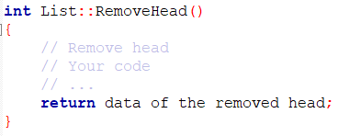
Implementation
For RemoveHead(), here is what you need to do:
Notice that you must return an integer.

Slide 6
Outline
Implementation of RemoveHead()
Contradiction with RemoveHead()
Try catch in main()
Add an if statement in RemoveHead()

Slide 7


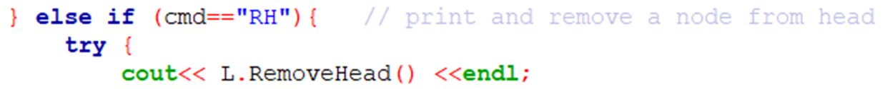
Contradiction
In the problem, you are asked to print a blank line if the list is empty.
However, this contradicts with what the main function does for you.
Remember that RemoveHead() returns an int

Slide 8
Outline
Implementation of RemoveHead()
Contradiction with RemoveHead()
Try catch in main()
Add an if statement in RemoveHead()

Slide 9
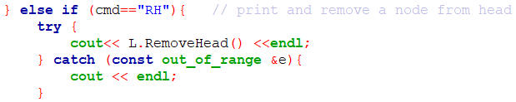
Exception Handling
If you look further, you can see that it’s actually handled by “try catch” in main.
“cout << endl;” is exactly what we want!!
But what exactly is “try catch”?

Slide 10
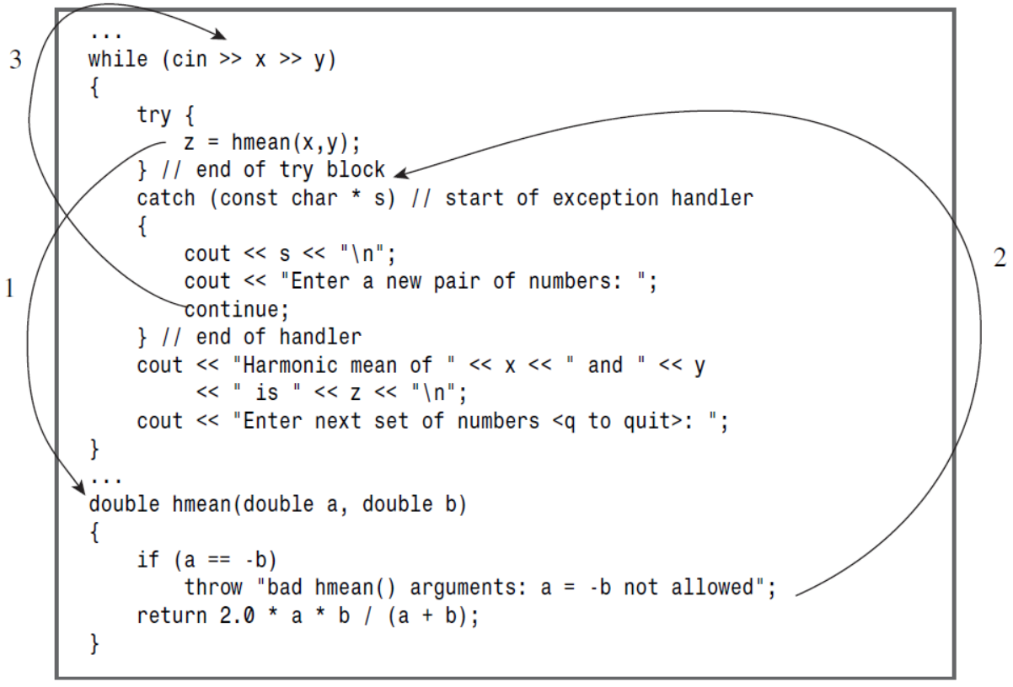
Exception Handling
The program calls hmean() within a try block.
hmean() throws an exception, transferring execution to the catch block, and assigning the exception string to s.
The catch block transfers execution back to the while loop.
Notes:
Reference: https://www.tutorialspoint.com/cplusplus/cpp_exceptions_handling.htm

Slide 11
Exception Handling
C++ exception handling is built upon three keywords: try, catch, and throw.
throw − A program throws an exception when a problem shows up. This is done using a throw keyword.
catch − A program catches an exception with an exception handler at the place in a program where you want to handle the problem. The catch keyword indicates the catching of an exception.
try − A try block identifies a block of code for which particular exceptions will be activated. It's followed by one or more catch blocks.
Notes:
Reference: https://www.tutorialspoint.com/cplusplus/cpp_exceptions_handling.htm

Slide 12
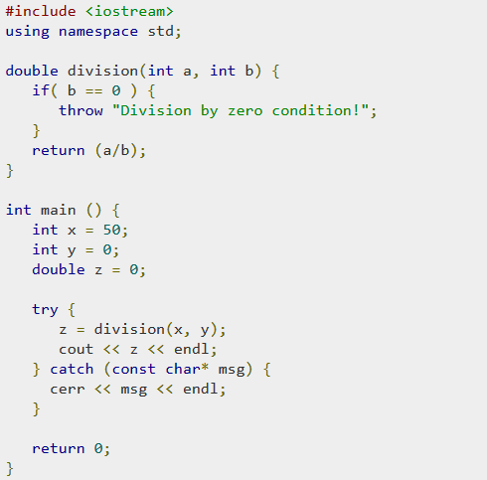
Exception Handling
One more example:
Notes:
Reference: https://www.tutorialspoint.com/cplusplus/cpp_exceptions_handling.htm

Slide 13
Outline
Implementation of RemoveHead()
Contradiction with RemoveHead()
Try catch in main()
Add an if statement in RemoveHead()

Slide 14
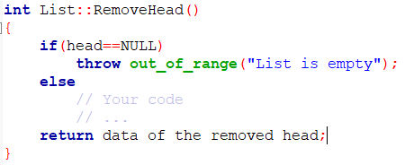
If statement
Therefore, you should add an if statement in RemoveHead() to handle the exception.
Notes:
The text in out_of_range(“…”) doesn’t matter.

Slide 15
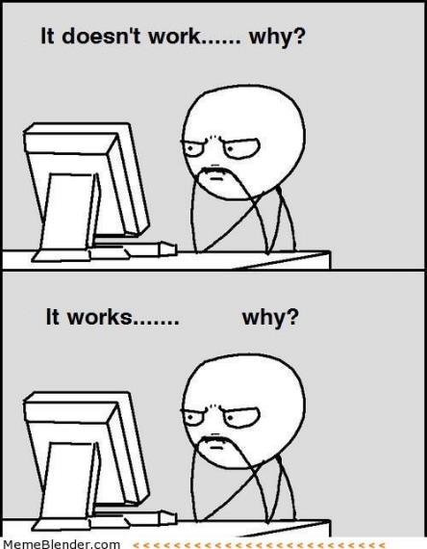
The end
Have a nice day!

